Slide 1
Natural Language Processing
CSCI 5832—Lecture 7
Jim Martin

Slide 2
Today
Text classification
Review naïve Bayes example
More on sentiment analysis
Logistic regression models

Slide 3
 | Doc | Words | Class
Training | 1 | Chinese Beijing Chinese | c
 | 2 | Chinese Chinese Shanghai | c
 | 3 | Chinese Macao | c
 | 4 | Tokyo Japan Chinese | j
Test | 5 | Chinese Chinese Chinese Tokyo Japan | ?
Priors:
P(c)=
P(j)=
Choosing a class:
P(c|d5)
P(j|d5)
3/4 * (3/7)³ * 1/14 * 1/14
≈ 0.0003
Conditional Probabilities:
P(Chinese|c) =
P(Tokyo|c) =
P(Japan|c) =
P(Chinese|j) =
P(Tokyo|j) =
P(Japan|j) =
(5+1) / (8+6) = 6/14 = 3/7
(0+1) / (8+6) = 1/14
(0+1) / (8+6) = 1/14
1/4 * (2/9)³ * 2/9 * 2/9
≈ 0.0001
(1+1) / (3+6) = 2/9
(1+1) / (3+6) = 2/9
(1+1) / (3+6) = 2/9

Slide 4
Sentiment Analysis
Sentiment analysis is the detection of attitudes “enduring, affectively colored beliefs, dispositions towards objects or persons”
This involves
Holder (source) of attitude
Target (aspect) of attitude
Type of attitude
From a set of types: Like, love, hate, value, desire, etc.
Or simple polarity: positive, negative, neutral, together with strength
Text containing the attitude
Sentence or entire document

Slide 5
Product Search

Slide 6
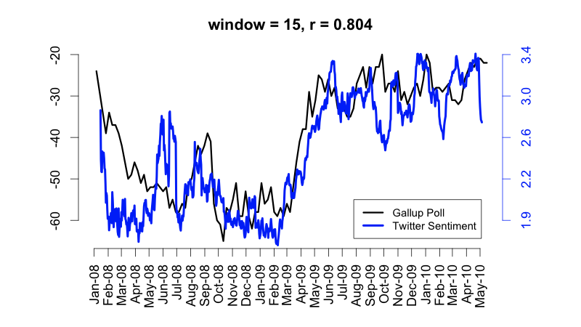
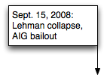
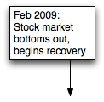
Twitter Sentiment
Notes:
Thanks to Brendan O’Connor and Noah Smith (email, 1/18/12) for permission to use this figure.

Slide 7
Back to Models
Naïve Bayes
Logistic regression
Also known as log linear or maximum entropy (maxent) models

Slide 8
Models
Bayesian methods are “generative”; they divide the problem into two components and combine them…
Why not just try to derive what we want directly? Just figure out P(c|d).

Slide 9
Logistic Regression Models
Estimate P(c|d) directly w/o Bayes using
Scoring function
Features
Weights
Classification function
Learning

Slide 10
Two Cases
We’ll start with a simple approach to (1) binary classification and then move to (2) multiclass classification
Binary classification means: Is this object x a member of a class or not

Slide 11
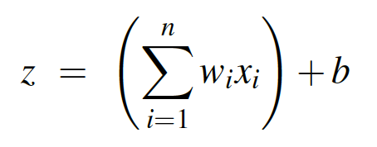
Scoring
We’ll represent documents as sets of features.
With each feature we’ll associate a weight (a real number).
We’ll then assign a score to each document

Slide 12
Scoring
Now we could just use that score and set a threshold such that if the score is > the threshold it’s in, otherwise its out.
Think about spam detectors. They are essentially computing a score for how spam-like a message is. If the score exceeds a threshold its blocked.

Slide 13
Better Scoring
A better approach is to formulate the score as a probability P(c|d).
This allows us to handle uncertainty in our classifications
Possibly useful in downstream applications
And it facilitates learning

Slide 14
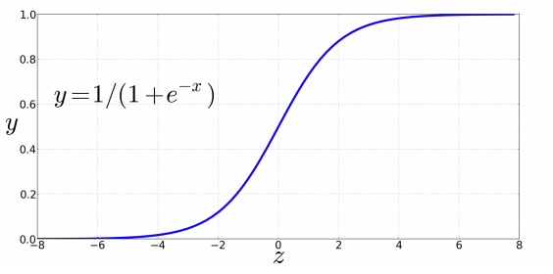
Better Scoring
So we’ll squash the scores to between 0 and 1 using a sigmoid function

Slide 15
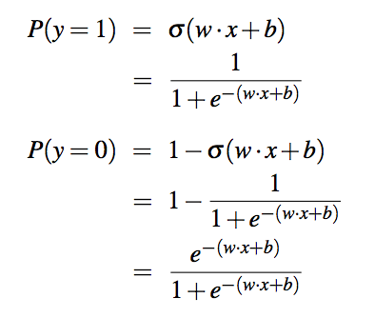
Better Scoring

Slide 16
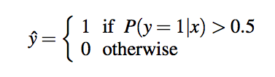
Decision Boundary

Slide 17
Features
The kind of features used in NLP-oriented machine learning systems are
Easily extracted from a text
Are often binary
Think of a feature as being on or off rather than as a feature with a value
E.g. Does this document contain a particular word
Typically have lots and lots of features (100,000s of features isn’t unusual.)

Slide 18
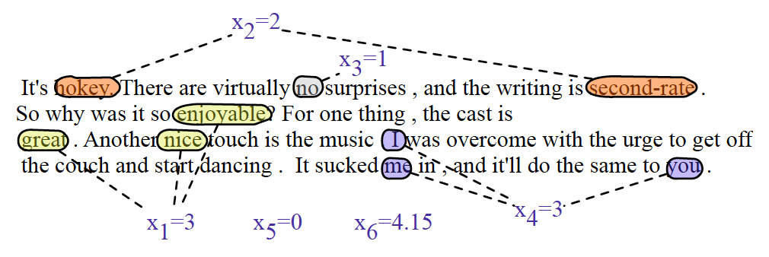
Sentiment Features

Slide 19
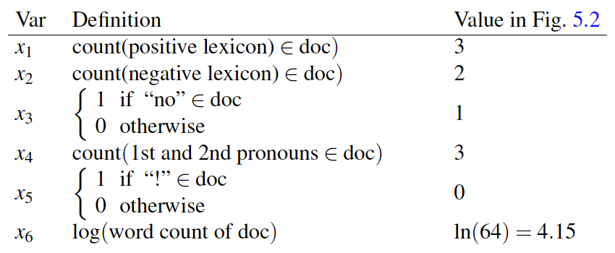
Sentiment Features

Slide 20
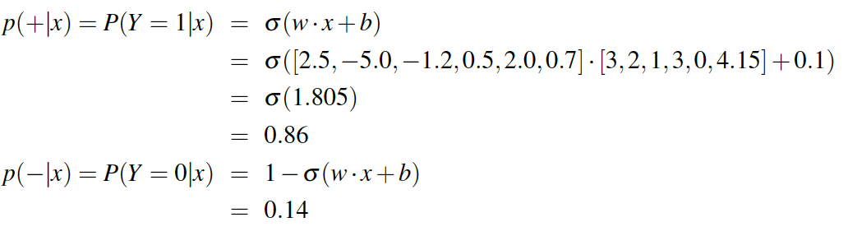
Scoring

Slide 21
Weights
So where do those weights come from?
We’ll learn the weights making use of a training set and a Loss Function.
Given some labeled training data, a loss function tells us how well we’re doing with the current weights.
The better we do, the lower the loss.

Slide 22
Loss Functions
There are lots of ways to measure how well we’re doing on a test/validation set.
How many examples are right?
How close our answers are to the correct answers?
What does close mean?
What’s the nature of the overall loss over the training/test data

Slide 23
Cross Entropy Loss (1)
Really very simple.
For a given example, we’ll go with the probability assigned to the right answer by the model
In the binary case, the right answer is always either 1 or 0. The model produces a number between 1 and 0, that’s the starting point for the loss.

Slide 24
Cross Entropy Loss
So if the correct answer for an example x is 1 and the system output is .7 then
?
If the system answer is .8 and the correct answer is 0 then
?

Slide 25
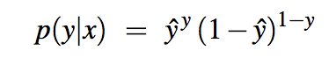
Cross Entropy Loss

Slide 26
Logs
As usual, probabilities aren’t exactly what we want. We want worse performance to have high loss and good performance to have low loss.
So we’ll take the negative of the log of the probability assigned to the correct answer as the loss

Slide 27
Log Prob

Slide 28
Negative Log Prob

Slide 29
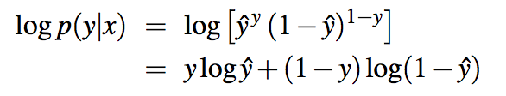
Cross Entropy Loss

Slide 30
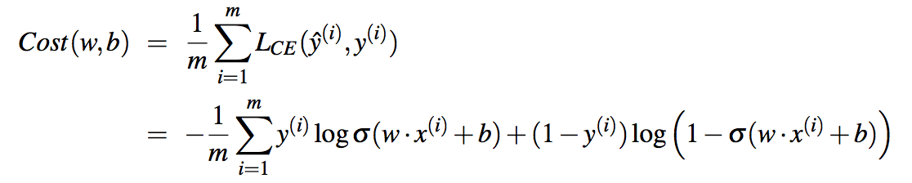
Learning
We want to find the weights and the bias that minimizes this loss across an entire training set.

Slide 31
Learning
We’ll do this by starting with a random set of weights and then iteratively updating those weights to lower this cost.

Slide 32
Learning

Slide 33
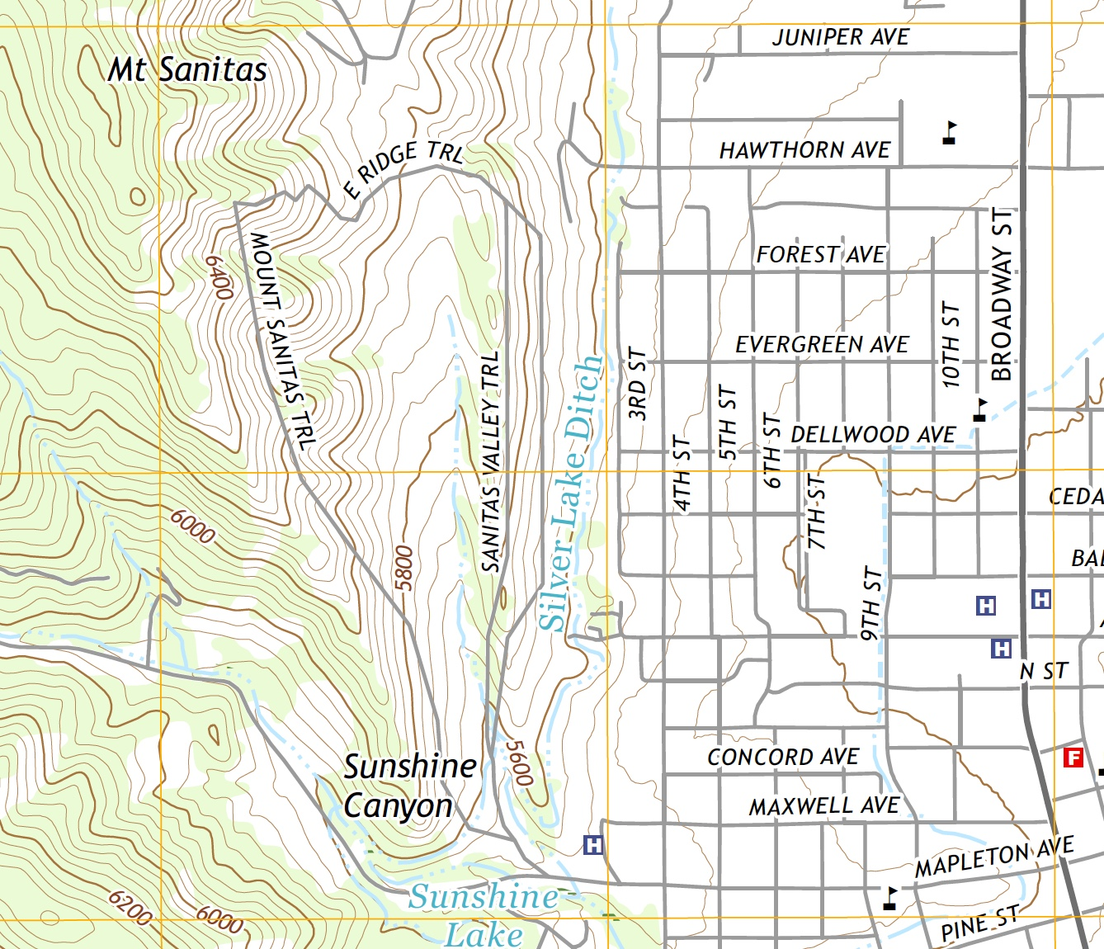
Motivation

Slide 34
Derivatives
Fortunately, we know how to do that from calculus… sort of.
If we take the derivative of the loss function wrt the weights that will tell us the direction and magnitude of change we should make.

Slide 35
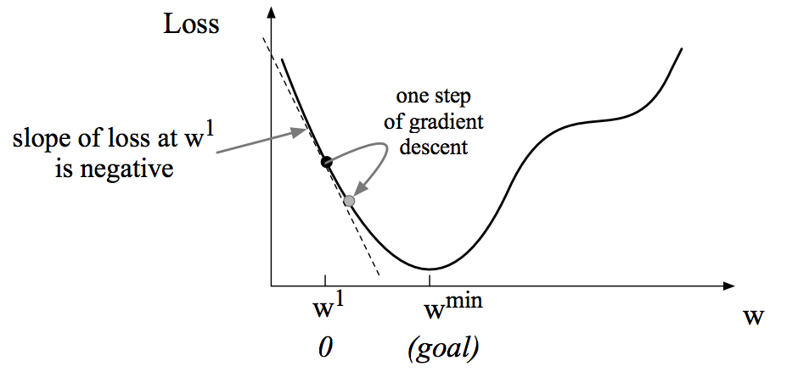
Single Weight

Slide 36
Partial Derivative
Of course, in real examples we don’t have one weight, we have thousands or millions.
So we need the vector of the partial derivative of the loss wrt the weights

Slide 37
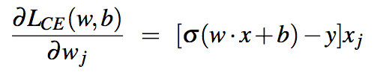
Partial Derivative

Slide 38
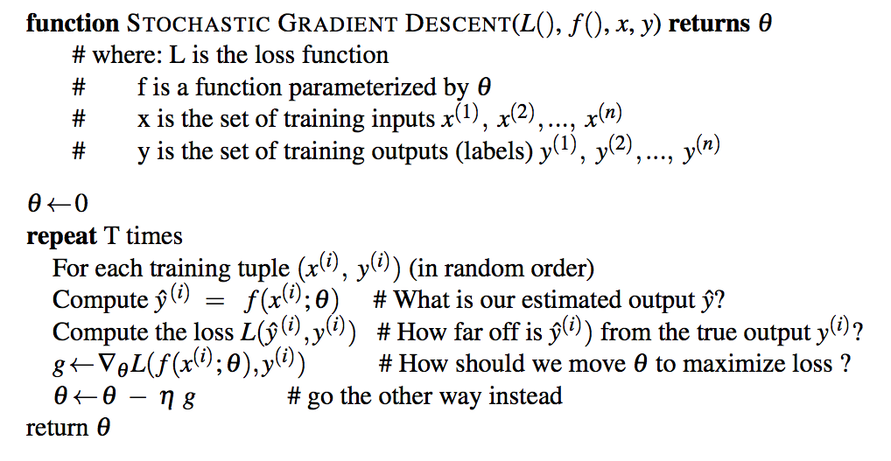
SGD

Slide 39
Optimization
In practice, that can be slow to converge because the algorithm can either be taking steps
That are too small and hence take us too long to get where we’re going
Or too large which leads us to overshoot the target and wander around too much
Fortunately, you don’t have to worry about this. Lots of packages available where you need to specify L and L’ and you’re done.

Slide 40
Multiclass Models
While useful, binary classification isn’t the typical use case in NLP. Rather we’re classifying and object into one of N categories.
We’d like a model that provides a probability distribution over the categories given an object.

Slide 41
Multiclass Models
Multinomial logistic regression
Softmax
Maximum entropy (Maxent) models
We’ll still assume we have objects represented as vectors of features, and weights on the features, and a scoring function.

Slide 42
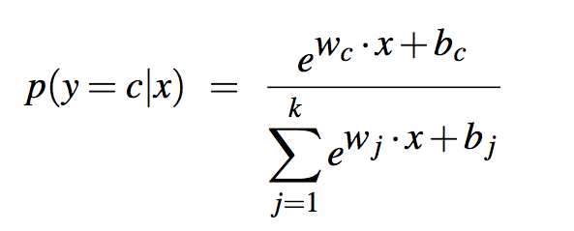
Softmax

Slide 43
Softmax Classification
Given an object x, the softmax function gives us the probability distribution over the classes.
We can take the argmax and go with that or we can simply use the distribution as the answer (passing it on for further processing).

Slide 44
Softmax Classification
We’ve seen two tasks so far
Language modeling (predict the next word)
POS tagging (assign a tag to a word)

Slide 45
Features
Weights are now indexed by class. Meaning the features are weighted wrt to class. So instead of n weights for n features we have k*n weights to learn.

Slide 46
Overfitting
A problem with the approach as we’ve described it is that it is overly eager to match the training set as closely as it can
With thousands or millions of features this can lead to poor performance on new data
With logistic models this usually manifests itself as extremely large weights on a small set of features

Slide 47
Regularization
Solution is to add a “penalty term” to the objective function.
The job of the penalty term is to squash the weights of features that are getting out of control.
Parameter > 0 learned from held out dev data.

Slide 48
Regularization and Learning
With regularization, the parameter learning has to balance finding models that match the training data well and use small weights.

